Slide 1
Math Instruction
Crofton Elementary PTA Meeting
February 5, 2018

Slide 2
AACPS Elementary Math Vision Statement
Our vision is to ensure an accessible, high quality mathematics education through a community of mathematically proficient learners who continually find the beauty of mathematics and all the opportunities mathematics affords.

Slide 3
Standards of Mathematical Practices

Slide 4
Components of a
Math Lesson
Number Sense Routine (5 minutes)
Pose a Problem (5 minutes)
The problem introduces the lesson/standard being taught.
Lesson (~ 20 minutes)
This is either a conceptual lesson, fluency lesson, or an application lesson.
Differentiated Instruction (~ 25 minutes)
Small group instruction to extend and enrich.
Check for Understanding (3 - 5 minutes)

Slide 5
Three Lesson Types
Conceptual – Whole Group Lesson
“You Do” – activates prior knowledge in order to extend understanding.
“We Do” – extends prior knowledge as students work.
“I Do” – teacher instruction explains the key concept behind the lesson and demonstrated how to solve the task.

Slide 6
Three Lesson Types
Fluency – Whole Group and Small Group Lesson
“You Do” – students solve a task that reinforces the standard being taught.
“I Do” – teacher explicitly teaches the strategy being practiced to help students develop and understand efficient strategies.
“We Do” and “You Do” – students practice concepts and teacher meets in small group to extend and reteach.

Slide 7
Three Lesson Types
Application – Whole Group Lesson
“You Do” – students are prepared for the application task with provided entry points.
“We Do” – students solve a real-world problem by applying their understanding of the standard.
“I Do” – teacher demonstrates how to complete the task and facilitates discussion around the solution(s).

Slide 8
Assessments
Grade One
Two Check Point Assessments per marking period
Grade Two
One Check Point Assessment per marking period
One District Assessment per marking period
Grades Three - Five
One District Assessment per marking period

Slide 9
Math Facts in a Flash
Computer-based program designed to support students with fact fluency/automaticity
Students can practice at home and at school, but must test at school
School goal of 30 minutes per week
K-2 Students are working on addition and subtraction
3-5 students are working on multiplication, division, and fractions.

Slide 10
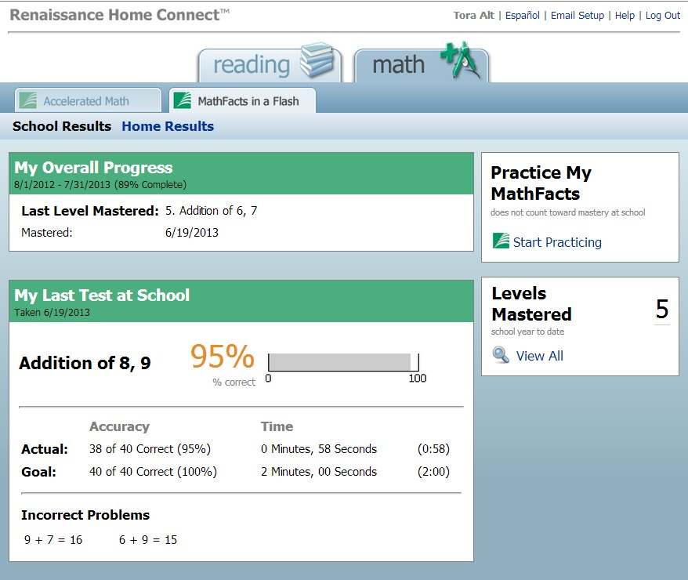
Math Facts in a Flash
You can access your child’s Math Facts in a Flash data through Renaissance Home Connect™.
You can view your child’s current level, and the problems that she missed on her last practice or test.
You can receive an email notification each time your child masters a level in Math Facts in a Flash at school.
Your child can practice the same math facts at home that he practices at school.

Slide 11
Questions
???

Slide 12
Let’s Play with Some Math

